Slide 1
Distributed Computing

Slide 2
What is distributed computing?
So far, we've discussed programs that can run on a single computer.
Most interesting computer applications involve many computers interacting with each other.
Distributed computing is using a bunch of computers that communicate and coordinate with each other to accomplish a common goal.

Slide 3
Big Data
"Big Data" processing is a common example of distributed computing
Big Data refers to extremely large datasets that can be analyzed to provide useful information.
Examples of Big Data:
Facebook's daily logs: 60 Terabytes (60,000 Gigabytes)
Google's web index: 10+ Petabytes (10,000,000 Gigabytes)
These datasets take a long time to read!
Reading 1 Terabyte of data from disk takes ~3 hours

Slide 4
Google Query Logs

Slide 5
How do computers communicate?
IP (Internet Protocol) provides an addressing system for computers
Every computer has a unique name and IP address
DNS (Domain Name System) is the yellowbook of the internet and provides a mapping of domain names to IP addresses.
Example:
Domain name: 'www.cs61a.org'
IP Address: '104.199.121.146'

Slide 6



How does the internet work?
Domain Name System
Given a domain name, I can tell you the IP address!

Slide 7
DNS in action!
Notes:
>>> from socket import gethostbyname
>>> gethostbyname('www.cs61a.org')
Note: In real life, the way computers interact involves a lot more complexity, but this is the basics :)

Slide 8
Client / Server Architecture
Client / Server Architecture is a way to disperse a service from a central source.
A server provides a service, and multiple clients communicate with the server to consume that service.
A server's role is to respond to requests from clients.
A client's role is to issue requests and make use of the server's response in order to perform their task of interest.

Slide 9
Client / Server Architecture
CS61A Server
request
response
request
response
request
response
Client
Client
Client
Notes:
The key here is that there is one server, and arbitrarily many clients.
These requests could all be happening at the same time, and the server needs to manage what each individual is asking for and deal with them at the same time.

Slide 10
Client / Server in action!
Notes:
(Inspect > Network)
The browser is the client, the computer that CS61A lives on is the server.
When a web browser of a web page, the domain name is looked up using DNS and then a request is sent to that server, asking for the page.
Here is all the content that the server provided!
Here, we see that, in response to my browser's request, cs61a provided a response of type "document" (HTML). We can also see how long it took for this response to be provided, and how long the DNS lookup took.
Another thing to note- in order to fully render the CS61A webpage, my browser needs to make a bunch of other requests as well, for javascript and CSS. There is more nuance into how all of this works as well.

Slide 11
Client / Server in Python!
Notes:
You can also make these requests directly without using a browser!
Python can make the request to retrieve this content using the urllib.request module:
>>> from urllib.request import urlopen
>>> response = urlopen('https://www.cs61a.org').read()
>>> response[:100]

Slide 12
Drawbacks of Client / Server Architecture
Single Point of Failure
If the server goes down, then the entire system is broken
Clients don't contribute any processing power
Computing resources become scarce if there are too many clients.
Clients increase demand on the system without contributing any computing resources.

Slide 13
Peer-to-Peer Systems
Peer-to-Peer (P2P) describes distributed systems where the labor is divided among all the computers in the system.
All computers that participate also contribute some processing power and memory.
As a P2P system increases in size, its capacity and computational resources increases too!
An identifying characteristic of a P2P system is division of labor among all participants.
This means the peers need to be able to communicate with each other reliably.

Slide 14
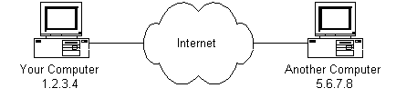
Tor (The "Dark Web")
Goal: Keep your internet activities hidden from advertisers, governments, and everyone else.
Normally, the server that you are sending requests to can see your IP address. Tor allows users to hide this information from everyone, even the server.
Your Computer
123.456.789.101
Server
230.432.543.234

Slide 15
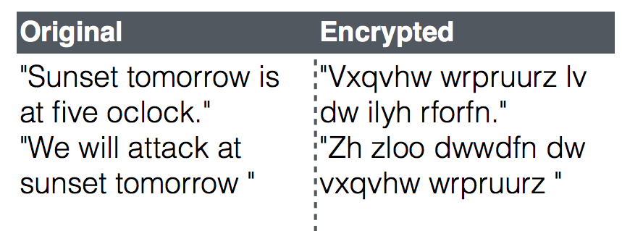
A Relevant Tangent on Encryption
Encrypting data means encoding data such that only trusted parties can decode and view the original data.
Usually, "decoding" involves using a "key" that only the trusted parties have.
Caesar Cipher
Notes:
Does anyone see the key?
Key is 3 shifts

Slide 16
Tor (The Onion Router)
When using Tor, every request you make is encased in multiple layers of encryption.
Then, your message is sent through a number of "intermediate nodes" that peel back those layers one by one.
"Intermediate nodes" = other computers who are in the Tor network
No single node can remove all the layers.
Each node only decrypts enough information to know where to send your request next. None of the nodes know your identity or the website that you are trying to access.

Slide 17
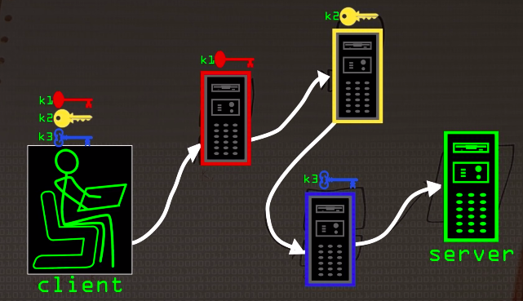
CS61A
Server
Source: Computerphile, Youtube

Slide 18
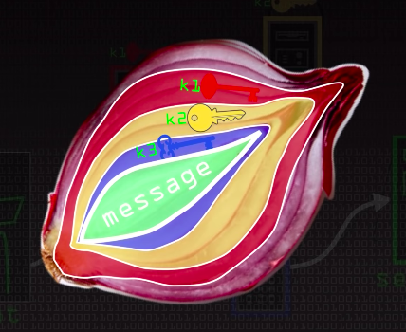
Source: Computerphile, Youtube

Slide 19
Tor (The Onion Router)
Tor as a Peer-to-Peer system
Often, users of Tor also serve as "intermediate nodes"
As more people use Tor, there is also more processing power for decrypting and passing along messages throughout the network
We are not reliant on one server to do all of that work!
Tor is not pure Peer-to-Peer
Tor relies on "directory servers" where you can look up which keys to encrypt your messages with.
Tor does not guaranteed anonymity
It doesn't prevent you from providing personal information.
It only hides your IP address and the website you are accessing from prying eyes.

Slide 20
Pros & Cons of Peer-to-Peer Systems
Benefits:
No single point of failure!
As the network grows, so does the number of computers contributing their computing resources.
Drawbacks:
Data Access
Absence of centralized server makes it difficult to backup data as data is located on different computers
Vulnerability
If someone controls too many nodes in the network, security can be compromised.

Slide 21
Parallel Computing
In practice, big companies do not use Peer-to-Peer, because they usually do not want to rely on untrusted clients to power their network.
Example of Parallel Computing: Big Data processing!
Recall how reading 1 TB of data would take ~3 hours.
What if we divided the work among 3 separate machines, which were all processing 1/3 of the data?
How long would it take to read 1 TB?

Slide 22
Parallel Computing
Parallel Computing allows us to divide up the work of a big problem on a bunch of different computers at the same time, and therefore speed up our computation.

Slide 23
Parallel Computing
Let's say I want to count all of today's Facebook posts that contain the word "CS61A" and Facebook's post dataset is 30 TB.
Instead of storing all of the data on one machine, I divide it up among 3 machines.
}
10 TB
Output: 5,000
Combiner
Output: 4,000
Sum: 14,600
10 TB
Output: 5,600
10 TB
Notes:
Key: None of these tasks are dependent on another. I own my data and can process it, and I am not affected by your result.

Slide 24

Fault Tolerance
What if one of the computers breaks?
What if one of the computers takes a long time?
}
10 TB
Output: 5,000
Combiner
Output: 4,000
Sum: 14,600
10 TB
Output: 5,600
10 TB

Slide 25
Cost vs. Reliability
10 TB
10 TB
}
10 TB
Output: 5,000
Combiner
10 TB
10 TB
Output: 4,000
Sum: 14,600
10 TB
Output: 5,600
10 TB
10 TB
10 TB
Notes:
show diagram of duplicate computers

Slide 26
Distributed Computing - It's all at your fingertips!
Client / Server Architecture
Host your own webpage on Github
Peer-to-Peer Systems
Mine bitcoin
Parallel Computing
Apache Spark
#notspon

